Slide 1
Face Emotion Detection
Presented by:- Kartikya Singhal
[ B.tech CSE]
(2016814)
Guided by:- Mr. Ashwini Kumar

Slide 2
What is Face Emotion Detection?
It is a technology that involves analyzing facial expressions to identify and classify the emotional states of individuals.
It is a branch of computer vision and artificial intelligence that uses algorithms to recognize and interpret facial features and expressions.
Through machine learning and pattern recognition algorithms, the system can classify these facial expressions into different emotional states, such as happiness, sadness, anger, surprise, fear, and disgust.

Slide 3
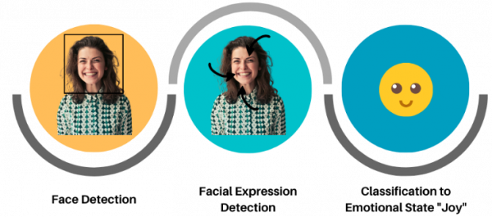
Introduction
Here’s an example of how it works:
It takes an image as an input, detect face from the image then it applies the model to detect the expression of the person in the image.

Slide 4
Methodology
Input dataset
Pre-process images in dataset
Train the deep learning Algorithms (Variation of Neural Networks)
Trained Model
Detect the face emotions in real time
Testing dataset
Pre-process images
Provide as an input to the model

Slide 5
Pre-processing
Normalization: Since computational complexity is high for computing pixel values in the range of (0-255), the data in pixel field is normalized to values between [0-1].
The face objects stored are reshaped and resized to the mentioned size of 48 X 48.
The respective emotion labels and their respective pixel values are stored in objects.
We use scikit-learn's train_test_split() function to split the dataset into training and testing data. The test_size being 0.1 meaning, 10% of data is for validation while 90% of the data will be trained.

Slide 6
Convolutional Neural network
It is a type of deep learning algorithm that is primarily used for analyzing visual data such as images or videos.
CNNs are designed to automatically learn and extract hierarchical patterns and features from input data through a series of interconnected layers.
Transfer Learning: - Transfer learning is a machine learning technique where a pre-trained model is used as a starting point for solving a new, related task. Instead of training a model from scratch on a large dataset, transfer learning leverages the knowledge and learned representations from a pre-existing model, which has been trained on a different but related task or dataset.

Slide 7
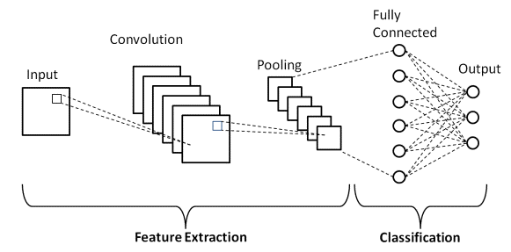
Convolutional Layers: - Convolutional layers in CNNs use filters or Kernels, each capturing different features of the input. These filters are learned during the training phase of the network, where the weights are adjusted to minimize the difference between the predicted output and the actual output.
Pooling Layers: - Pooling layers reduce the spatial dimensions of the feature maps.
Dense Layers: - These layers are responsible for making predictions based on the extracted features.

Slide 8
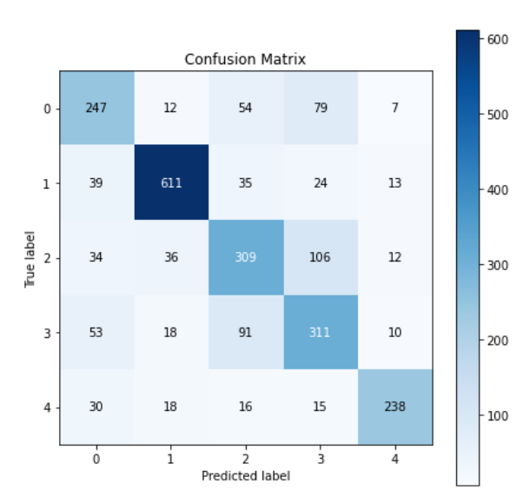

Result and Discussion
As seen in the image the accuracy on the test data is 71%.
The accuracy is low because of many variations in the dataset and due to its large size.
Despite of low accuracy the model is working well in real-time.

Slide 9
Conclusion and Future Work
CONCLUSION:
I used CNN for face emotion detection and it give accuracy of about 71%.
This technique is used to classify the human emotions in 5 categories angry, happy, neutral, sad, surprise.
FUTURE WORK:
This project can be extended to the more classes as our model now works only for 5 classes.
We can try to play with the model to find out different models and check if we get more accuracy.

Slide 10
DEMO

Slide 11


